Slide 1
Green Leaf The Smile
Team members
An Eui Hyun
Alabdulwahab Abrar
Jamshid Khaytbaev

Slide 2
Fake it till you make it

Slide 3




Background
Start Your Day ~
Through The Day

Slide 4



Background

Slide 5
Concepts

Slide 6


Weather and Schedule
Forecast
Tu: Rainy☔
Tu :Rainy☔
Tu :Rainy☔
Smile
Smile
Schedule:
Do the PPT
Do the PPT
Do the PPT

Slide 7





Forecast
Tu: Rainy☔
Tu :Rainy☔
Tu :Rainy☔
Picture Time
Schedule:
Do the PPT
Do the PPT
Do the PPT

Slide 8





















Slide 9
Hardware Design

Slide 10
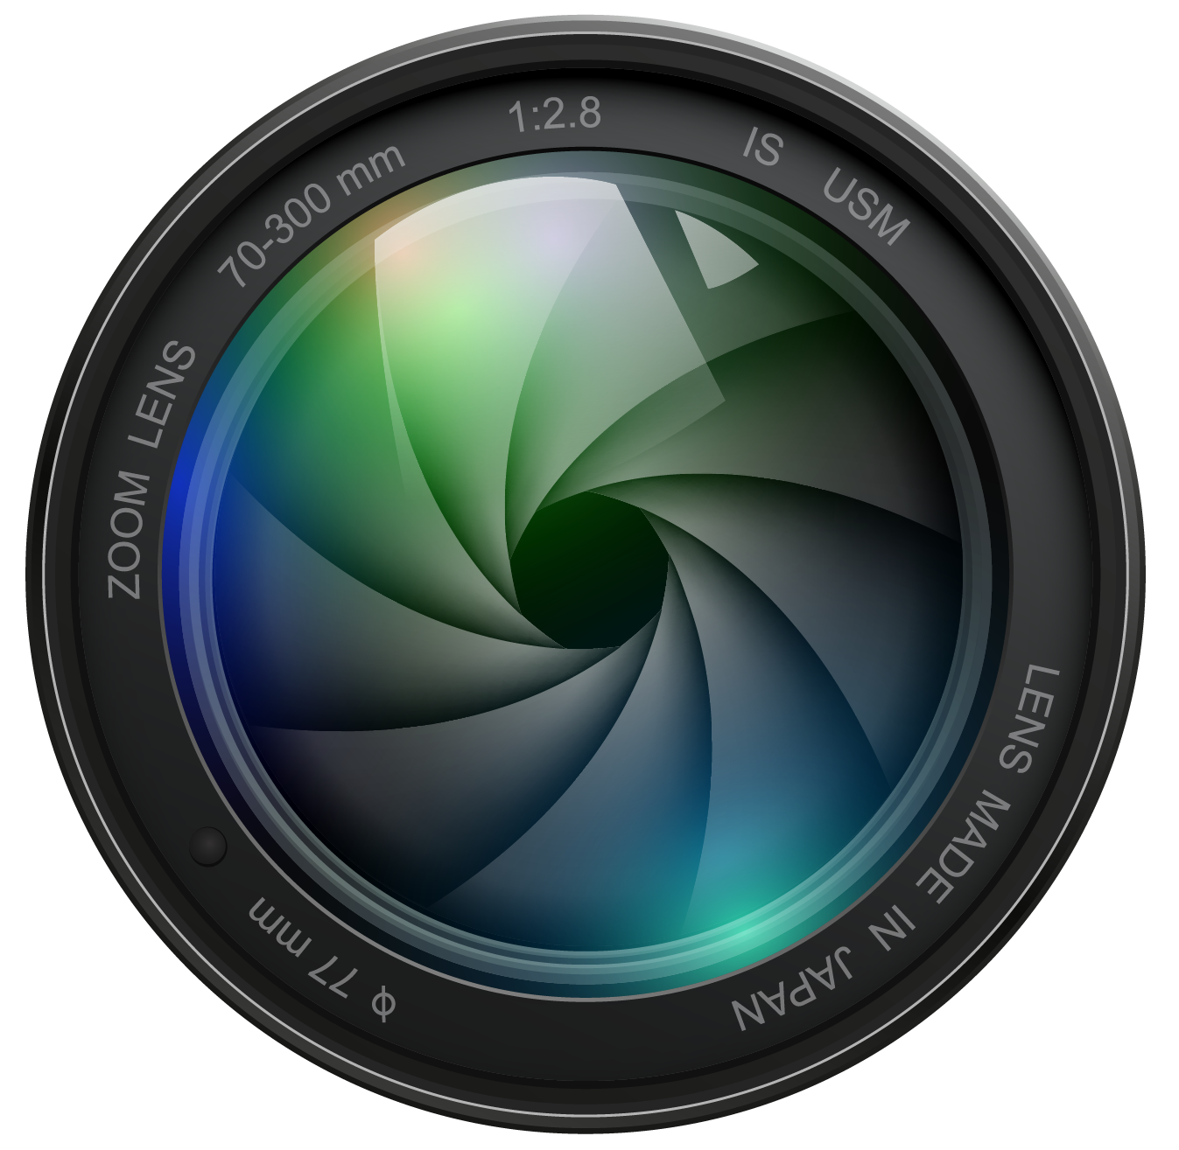
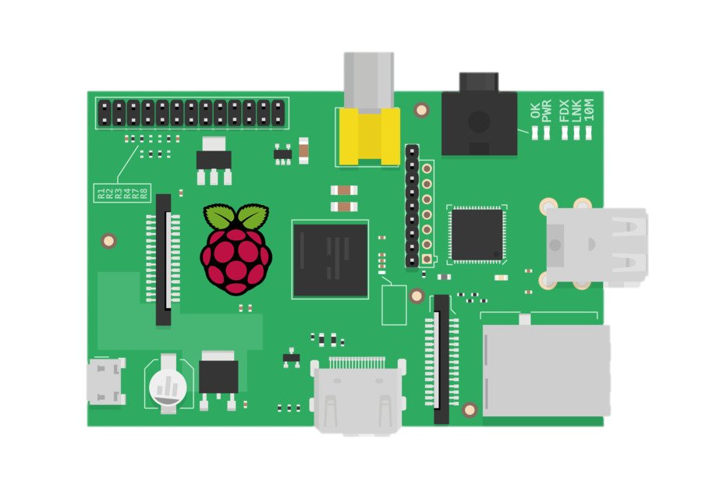
Design
Raspberry pi
Camera
Monitor
Glass
Mirror
Frame
Notes:
So as you can see here first the Raspberry Pi will go behind the monitor and after that we will attach the the glass in front of the monitor and after that we will bring the glass roll or glass I mean the mirror miraero and stick it to the glass and after that we will made our own frame and put it in the end

Slide 11
Design
Smart Mirror
Notes:
And then we will be we will have this kind of result and it will shows the date schedule and the I face detection

Slide 12
Graphic Design

Slide 13
Wednesday, September 22,2021
12:28
_____________________________
Columbus Day
Halloween
Veterans Day
Thanksgiving Day
Christmas
Holidays
Oct 11th
Oct 31st
Nov 11th
Nov 25th
Dec 25th
Hey Handsome

Slide 14



Graphic Design

Slide 15
The Magic Mirror

Slide 16
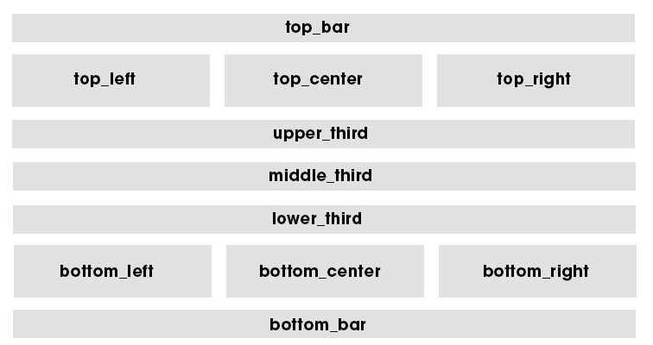

Slide 17
Go to our Pi Command

Slide 18
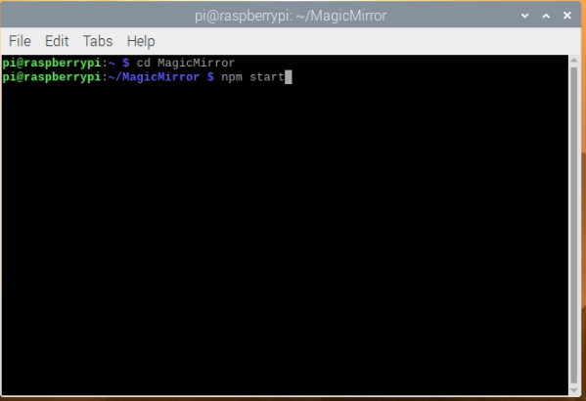

Slide 19
We can see the layout in action

Slide 20
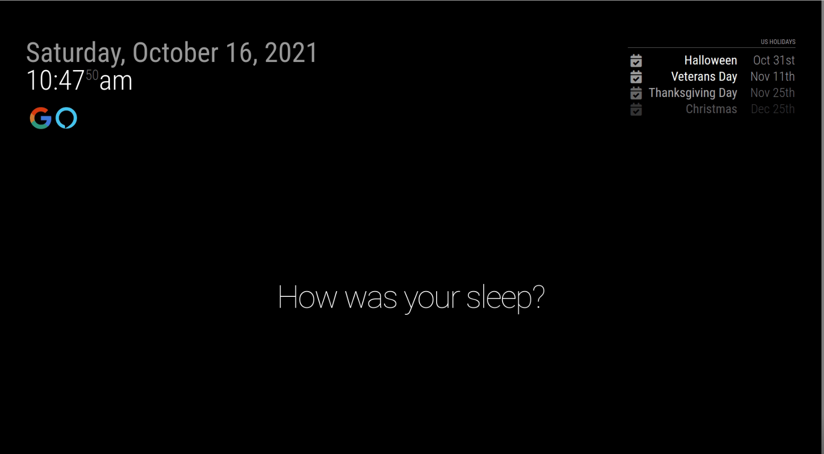

Slide 21
Default Modules

Slide 22

{
module:“alert“,
},
{
module:"updatenotification“,
},
{
module:"clock“,
},
{
module:“calendar“,
},
{
module:"compliments “,
},
Default

Slide 23
Installed Modules

Slide 24


{
module: "MMM-Detector",
position: "top_left",
configDeepMerge: true,
config: {
debug: false,
}
MMM-Detector
module:"MMM-GoogleAssistant",
position: "bottom_bar",
configDeepMerge: true,
MMM-GoogleAssistant

Slide 25
Google Assistant

Slide 26
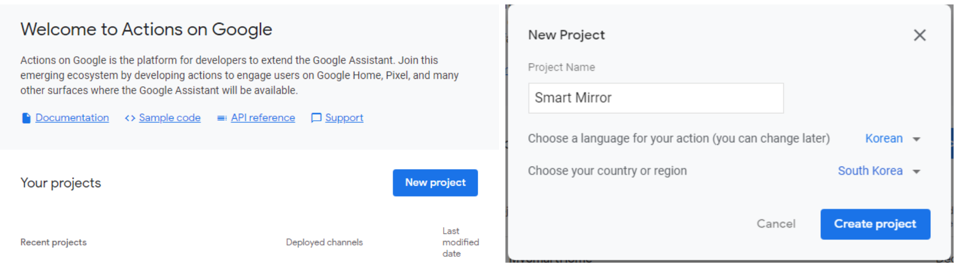
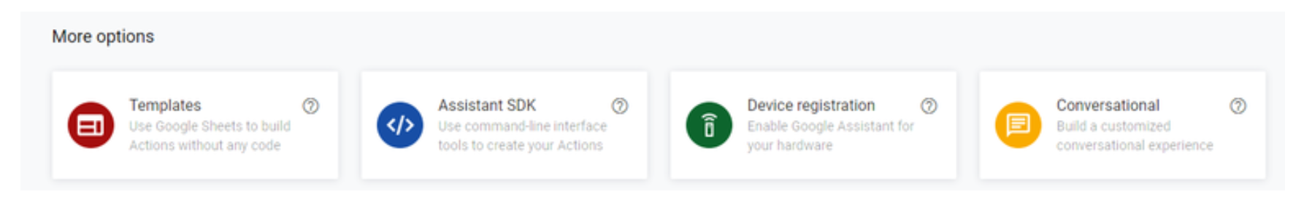

Slide 27
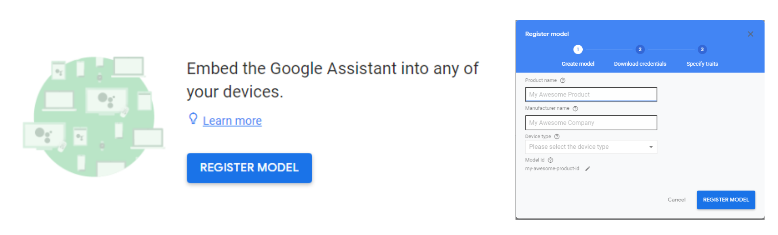

Slide 28
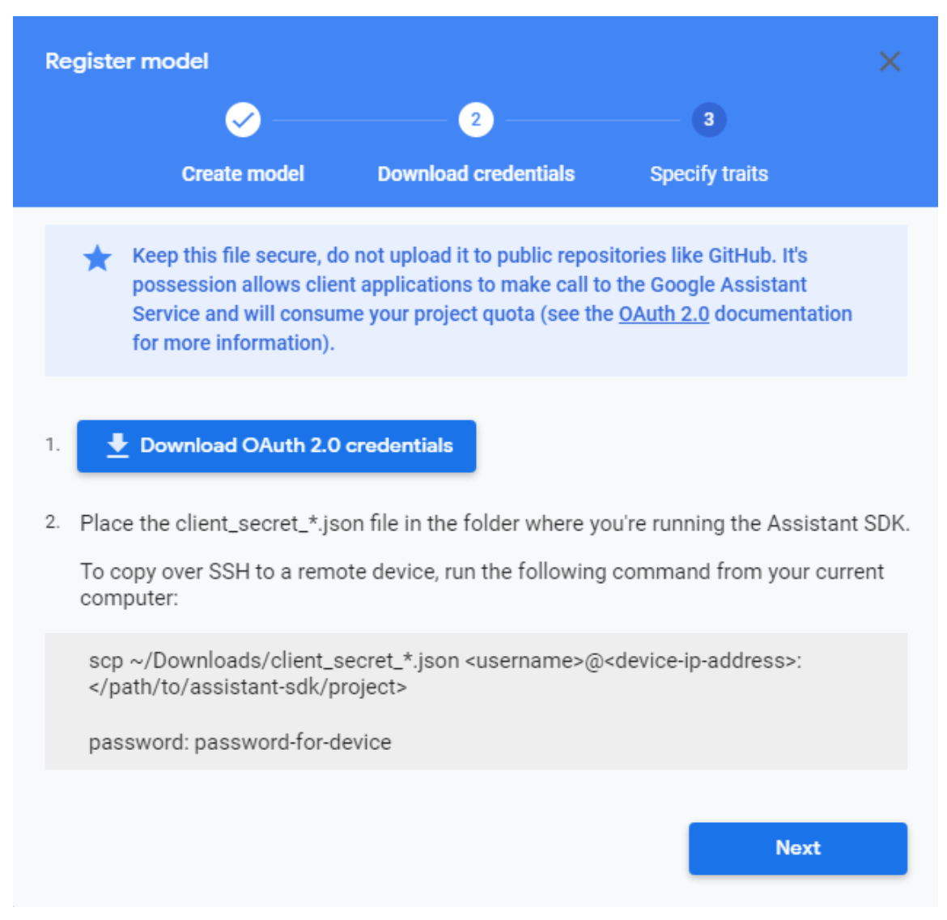
Change the name
Credentials.json

Slide 29
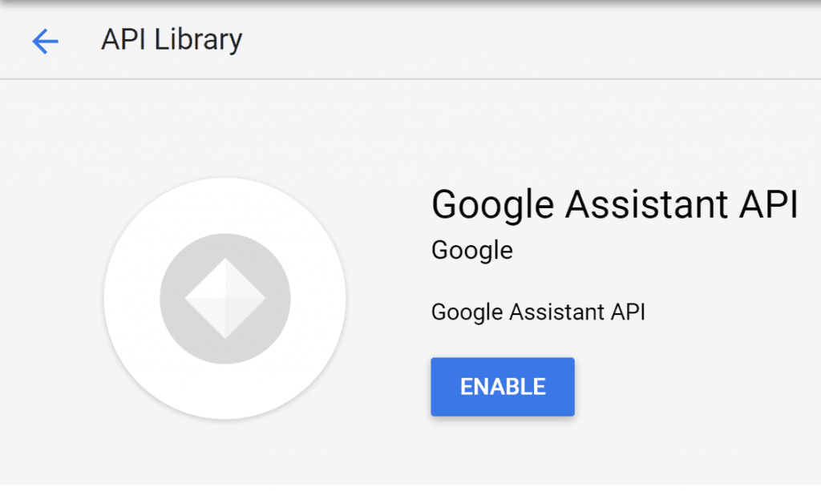

Slide 30
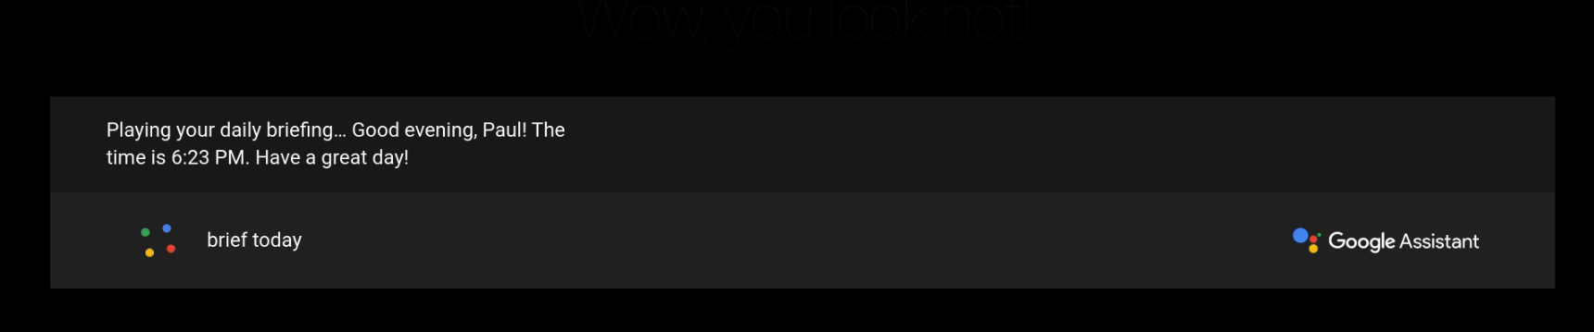

Slide 31
Adding Calendar Events

Slide 32
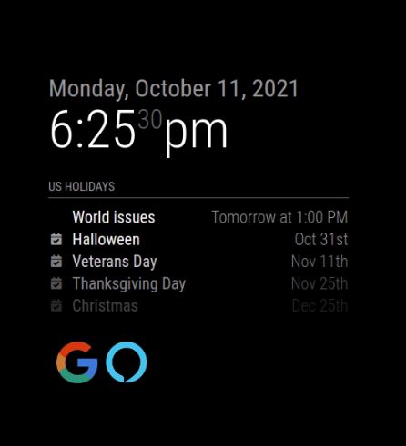
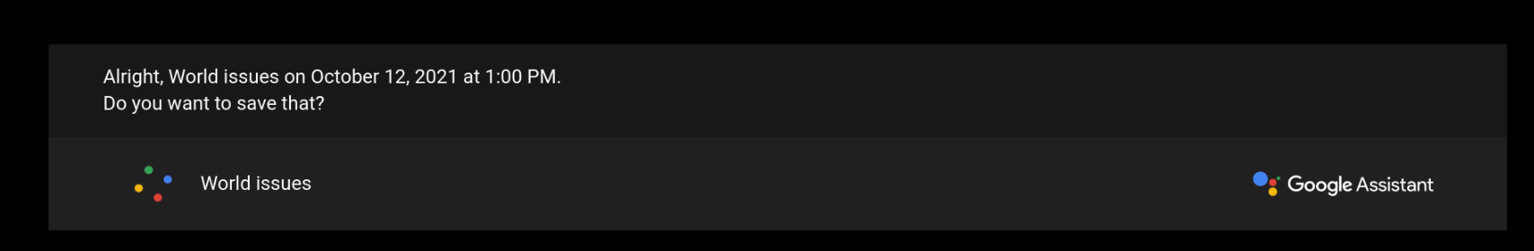

Slide 33
Compliments

Slide 35
Smile Camera

Slide 36

Smile
main.py
haarcascade_smile.xml
haarcascade_frontalface_default.xml
sel.png

Slide 37
Smile
main.py
cap = cv2.VideoCapture(1) face_cascade = cv2.CascadeClassifier('haarcascade_frontalface_default.xml') smile_cascade = cv2.CascadeClassifier('haarcascade_smile.xml')
for x, y, w, h in face: cv2.rectangle(frame, (x, y), (x + w, y + h), (0, 255, 255), 2) face_roi = frame[y:y + h, x:x + w] gray_roi = gray[y:y + h, x:x + w] smile = smile_cascade.detectMultiScale(gray_roi, 1.3, 25) for x1, y1, w1, h1 in smile: cv2.rectangle(face_roi, (x1, y1), (x1 + w1, y1 + h1), (0, 0, 255), 2) cv2.imwrite('sel.png', original_frame) mail_content = '''Thank you for smiling,

Slide 38



Automated Email
Hardware
Combine
Sending Emails
Wednesday, September 22,2021
12:28
____________________________
Columbus Day
Halloween
Veterans Day
Thanksgiving Day
Christmas
Holidays
Oct 11th
Oct 31st
Nov 11th
Nov 25th
Dec 25th

Slide 39
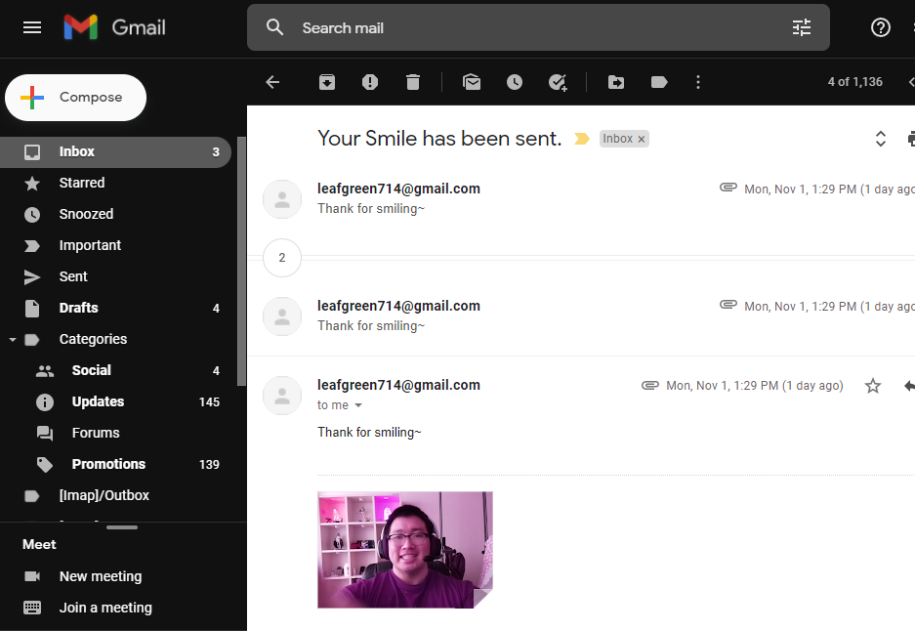

Slide 40


Assigning the Roles
Abrar Alabdulwahab
Jamshid
Khaytbaev
An Eui Hyun
PPT
Add to open source
Face recognition code
Team Leader
Test /fix the open source
Face recognition code
Making hardware
Research open source
Face recognition code
Research automated emails

Slide 41
Thank You~

